Slide 1
Chapter 14 – Security Engineering 安全工程
Lecture 1
Chapter 14 Security Engineering

Slide 2
Topics covered 包含的主题
Security engineering and security management
安全工程与安全管理
  Security engineering concerned with applications; security management with infrastructure.
  安全工程关心应用程序;安全管理关心基础设施
Security risk assessment
安全风险评估
  Designing a system based on the assessment of security risks.
  设计一个系统要基于安全风险评估
Design for security
安全设计
  How system architectures have to be designed for security.
  系统架构必须如何进行安全性设计
Chapter 14 Security Engineering

Slide 3
Security engineering 安全工程
Tools, techniques and methods to support the development and maintenance of systems that can resist malicious attacks that are intended to damage a computer-based system or its data.
支持系统开发和维护的工具，技术和方法能阻止企图破坏计算机系统或者数据的恶意攻击。
A sub-field of the broader field of computer security.
计算机安全的更广泛领域的子领域
Assumes background knowledge of dependability and security concepts (Chapter 10) and security requirements specification (Chapter 12)
假设背景知识的可靠性和安全概念和安全需求规范
Chapter 14 Security Engineering

Slide 4
Application/infrastructure security
应用/基础设施安全
Application security is a software engineering problem where the system is designed to resist attacks.
应用安全是一个软件工程问题，这里要求被设计的系统能抵挡攻击。
Infrastructure security is a systems management problem where the infrastructure is configured to resist attacks.
基础设施安全是一个系统管理问题，这里要求配置的基础设施要能抵挡攻击。
The focus of this chapter is application security.
本章的重点是应用安全。
Chapter 14 Security Engineering

Slide 5
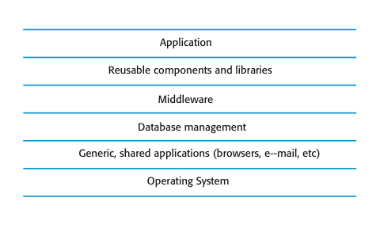
System layers where security may be compromised系统层的安全可能会受到损害
When you consider security issues, you have to consider both the application software and the infrastructure on which this system is built.
当你考虑安全性问题，你需要同时考虑系统的应用安全以及基础设施安全。
Middleware supports distributed computing and database access.
中间件：支持分布式计算和数据库访问
infrastructure
Chapter 14 Security Engineering

Slide 6
System security management系统安全管理
User and permission management用户和权限管理
  Adding and removing users from the system and setting up appropriate permissions for users
  从系统中添加和删除用户，为用户设置合适的权限。
Software deployment and maintenance 软件部署和维护
  Installing application software and middleware and configuring these systems so that vulnerabilities are avoided.
  安装应用程序，中间件以及配置这些系统能够避免缺陷。
Attack monitoring, detection and recovery 监视，检测和恢复攻击
  Monitoring the system for unauthorized access, design strategies for resisting attacks and develop backup and recovery strategies.
  监视系统的非法访问，设计抵抗攻击的策略，建立备份和恢复策略。
Chapter 14 Security Engineering

Slide 7
14.1 Security risk management 安全风险管理
Risk management is concerned with assessing the possible losses that might ensue from attacks on the system and balancing these losses against the costs of security procedures that may reduce these losses.
风险管理涉及评价系统遭遇攻击后的可能损失以及均衡这些损失需要的安全程序的成本。
Risk management should be driven by an organisational security policy.
风险管理应该是由一个组织的安全政策驱动
Risk management involves 风险管理包括
  Preliminary risk assessment 初步风险评估
  Life cycle risk assessment 生命周期风险评估
  Operational risk assessment 操作风险评估
Chapter 14 Security Engineering

Slide 8
Preliminary risk assessment 初步风险评估
Preliminary risk assessment focuses on deriving security requirements.
初步风险评估重点是派生的安全要求
At this stage, decisions on the detailed system requirements, the system design, or the implementation technology have not been made.
在这个阶段，详细的系统需求，系统设计或者实现技术都没有确定。
The aim of this assessment process is to decide if an adequate level of security can be achieved at a reasonable cost. If this is the case, you can then derive specific security requirements for the system.
这个评估过程的目的是确定一个适当安全级别可以用一个合理的成本来实现。如果是这样的话，你就可以得到系统明确的安全需求。
You do not have information about potential vulnerabilities in the system or the controls that are included in reused system components or middleware.
你不知道系统潜在的漏洞以及可重用的系统组件和中间件的控制
Chapter 14 Security Engineering

Slide 9
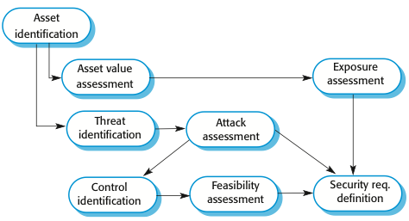
Preliminary risk assessment 初步风险评估
Asset：资产，有点 identification：鉴定 feasibility可行性 exposure 曝光
The preliminary risk assessment process for security requirements
安全需求的初步风险评估过程
Chapter 14 Security Engineering

Slide 10
Misuse cases 滥用案例
Misuse cases are scenarios that represent malicious interactions with a system(instances of threats to a system). Pfleeger C. P. and Pfleeger S. L.(2007) characterize threats under four headings, which may be used as a starting point for identifying possible misuse cases. These headings are:
滥用案例场景代表恶意交互系统（威胁系统的实例）。 Pfleeger C. P. and Pfleeger S. L.(2007) 描述威胁的4个标题，这可能是用做识别可能的滥用情况下的一个起点。这些标题是：
  Interception threats 拦截威胁
    Attacker gains access to an asset 攻击者获得访问资源
  Interruption threats 中断威胁
    Attacker makes part of a system unavailable 攻击者使部分系统瘫痪
  Modification threats 修改威胁
    Allow an attacker to tamper with a system asset 允许攻击者篡改系统资产
  Fabrication threats 捏造威胁
    False information is added to a system 虚假信息被添加到系统
Chapter 14 Security Engineering

Slide 11
Asset analysis 资源分析
Asset | Value | Exposure
The information system 信息系统 | High. Required to support all clinical consultations. Potentially safety-critical. 高.需要支持所有临床咨询。潜在的安全性至关重要 | High. Financial loss as clinics may have to be cancelled. Costs of restoring system. Possible patient harm if treatment cannot be prescribed.经济损失作为诊所可能不得不被取消。恢复系统的成本。可能病人伤害如果无法规定处理
The patient database 病人数据库 | High. Required to support all clinical consultations. Potentially safety-critical. | High. Financial loss as clinics may have to be canceled. Costs of restoring system. Possible patient harm if treatment cannot be prescribed.
An individual patient record 病人个人记录 | Normally low although may be high for specific high-profile patients.通常情况下低 ，但是对特定的高调病人高。 | Low direct losses but possible loss of reputation. 直接损失低，但会损失名誉
Chapter 14 Security Engineering

Slide 12
Threat and control analysis威胁和控制分析
Threat | Probability | Control | Feasibility
Unauthorized user gains access as system manager and makes system unavailable未经授权的用户访问系统管理器,使系统不可用 | Low | Only allow system management from specific locations that are physically secure.只允许从特定位置,物理安全系统管理 | Low cost of implementation but care must be taken with key distribution and to ensure that keys are available in the event of an emergency.低成本实现,但必须注意与密钥分发,并确保在紧急事件可得到钥匙
Unauthorized user gains access as system user and accesses confidential information未经授权的用户获得访问系统用户和访问机密信息 | High | Require all users to authenticate themselves using a biometric mechanism. Log all changes to patient information to track system usage.要求所有用户自己使用的生物机制进行身份验证。记录所有修改病人信息跟踪系统使用。 | Technically feasible but high-cost solution. Possible user resistance. Simple and transparent to implement and also supports recovery.技术上可行,但高成本的解决方案。可能用户的阻力。简单而透明的实现,还支持复苏。
Chapter 14 Security Engineering

Slide 13
Security requirements安全需求
Patient information must be downloaded at the start of a clinic session会话 to a secure area on the system client that is used by clinical staff.
Patient information must not be maintained on system clients after a clinic session has finished.
A log on a separate computer from the database server must be maintained of all changes made to the system database.
Chapter 14 Security Engineering

Slide 14
14.1.1 Life cycle risk assessment生命周期的风险评估
Risk assessment while the system is being developed and after it has been deployed
More information is available - system platform, middleware and the system architecture and data organisation.
Vulnerabilities漏洞 that arise from design choices may therefore be identified.
Chapter 14 Security Engineering

Slide 15
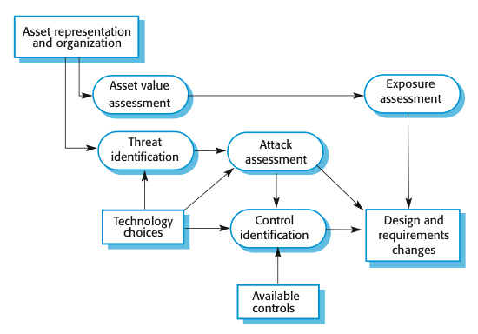
Life-cycle risk analysis生命周期风险分析
Chapter 14 Security Engineering

Slide 16
Design decisions from use of COTS
使用COTS的设计决策
When you develop an application by reusing an existing system, you have to accept the design decisions made by the developers of that system.
Let us assume that some of these decisions are as follows:
System users are authenticated using a name/password combination.
The system architecture is client-server, with clients accessing data through a standard web browser.
Information is presented to users as an editable web form. They can change information in place and upload the revised information to the server.
Chapter 14 Security Engineering

Slide 17
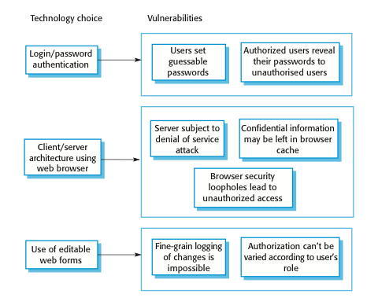
Vulnerabilities associated with technology choices
漏洞与技术选择相关
For a generic system, the above design decisions are perfectly acceptable, but a lifecycle risk analysis reveals that they have associated vulnerabilities. Examples of possible vulnerabilities are shown in the following figure:
Chapter 14 Security Engineering

Slide 18
Security requirements·安全需求
Some(not all) examples of requirements proposed to address the inherent vulnerabilities might be the following:
A password checker program shall be made available and shall be run daily. Weak passwords shall be reported to system administrators.
Access to the system shall only be allowed by approved client computers.
All client computers shall have a single, approved web browser installed by system administrators.
Chapter 14 Security Engineering

Slide 19
14.1.2 Operational risk assessment 操作风险评估
Continuation of life cycle risk assessment but with additional information about the environment where the system is used.
Environment characteristics can lead to new system risks
  For example, say a system is being used in an environment in which users are frequently interrupted. Risk of interruption means that logged in computers are left unattended.
  It may be possible for an unauthorized person to gain access to the information in the system.
  This could then generate a requirement for a password-protected screen saver to be run after a short period of inactivity.
Chapter 14 Security Engineering

Slide 20
14.2 Design for security·安全设计
Architectural design
  how do architectural design decisions affect the security of a system?
Good practice
  what is accepted good practice when designing secure systems?
Design for deployment
  what support should be designed into a system to avoid the introduction of vulnerabilities when a system is deployed for use?
Chapter 14 Security Engineering

Slide 21
14.2.1 Architectural design 架构设计
Two fundamental issues have to be considered when designing an architecture for security.
  Protection
    How should the system be organised so that critical assets can be protected against external attack?
  Distribution
    How should system assets be distributed so that the effects of a successful attack are minimized?
These are potentially conflicting冲突
  If assets are distributed, then they are more expensive to protect. If assets are protected, then usability and performance requirements may be compromised.
Chapter 14 Security Engineering

Slide 22
Protection保护
Platform-level protection
  Top-level controls on the platform on which a system runs.
Application-level protection
  Specific protection mechanisms built into the application itself e.g. additional password protection.
Record-level protection
  Protection that is invoked when access to specific information is requested
These lead to a layered protection architecture shown in next slide.
Chapter 14 Security Engineering

Slide 23
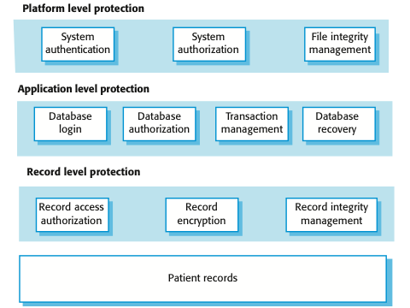
A layered protection architecture
一个分层保护的体系结构
A layered protection architecture
Chapter 14 Security Engineering

Slide 24
Distribution·分配
Distributing assets means that attacks on one system do not necessarily lead to complete loss of system service
Each platform has separate protection features and may be different from other platforms so that they do not share a common vulnerability
Distribution is particularly important if the risk of denial of service attacks is high
Chapter 14 Security Engineering

Slide 25
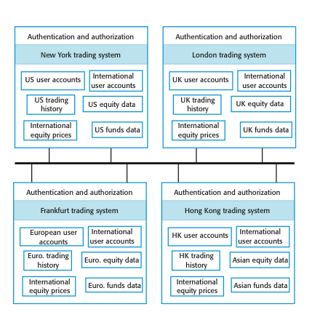
Distributed assets in an equity trading system
在一个股票交易系统中的分布式资产
Chapter 14 Security Engineering

Slide 26
Key points
Security engineering is concerned with how to develop systems that can resist malicious attacks
Security threats can be threats to confidentiality, integrity or availability of a system or its data
Security risk management is concerned with assessing possible losses from attacks and deriving security requirements to minimise losses
Design for security involves architectural design, following good design practice and minimising the introduction of system vulnerabilities
安全工程是关心如何开发系统能够抵御恶意攻击
安全威胁可以威胁到一个系统或其数据的机密性、完整性和可用性的
安全风险管理是关心评估可能的攻击造成的损失和产生的安全需求来将损失降至最低
安全设计涉及到架构设计,遵循好的设计实践，最小化引入系统漏洞
Chapter 14 Security Engineering

Slide 27
Chapter 14 – Security Engineering
Lecture 2
Chapter 14 Security Engineering

Slide 28
Topics covered
Design guidelines指导方针 for security
  Guidelines that help you design a secure system
Design for deployment
  Design so that deployment problems that may introduce vulnerabilities are minimized
System survivability生命力
  Allow the system to deliver essential services when under attack
Chapter 14 Security Engineering

Slide 29
14.2.2 Design guidelines for security engineering
安全工程设计指南
Design guidelines encapsulate good practice in secure systems design
Design guidelines serve two purposes:
  They raise awareness of security issues in a software engineering team. Security is considered when design decisions are made.
  They can be used as the basis of a review checklist that is applied during the system validation process.
Design guidelines here are applicable during software specification and design
Chapter 14 Security Engineering

Slide 30
Design guidelines for secure systems engineering软件工程设计安全指南
Security guidelines
Base security decisions on an explicit security policy
Avoid a single point of failure
Fail securely
Balance security and usability
Log user actions
Use redundancy and diversity to reduce risk
Validate all inputs
Compartmentalize your assets
Design for deployment
Design for recoverability
Chapter 14 Security Engineering

Slide 31
Design guidelines 1-3`设计指南1-3
Base decisions on an explicit security policy明确安全政策
  Define a security policy for the organization that sets out the fundamental security requirements that should apply to all organizational systems.
Avoid a single point of failure
  Ensure that a security failure can only result when there is more than one failure in security procedures. For example, have password and question-based authentication.
Fail securely
  When systems fail, for whatever reason, ensure that sensitive information cannot be accessed by unauthorized users even although normal security procedures are unavailable.
Chapter 14 Security Engineering

Slide 32
Design guidelines 4-6`设计指南4-6
Balance security and usability
  Try to avoid security procedures that make the system difficult to use. Sometimes you have to accept weaker security to make the system more usable.
Log user actions
  Maintain a log of user actions that can be analyzed to discover who did what. If users know about such a log, they are less likely to behave in an irresponsible way.
Use redundancy and diversity to reduce risk
  Keep multiple copies of data and use diverse infrastructure so that an infrastructure vulnerability cannot be the single point of failure.
Chapter 14 Security Engineering

Slide 33
Design guidelines 7-10
Validate验证 all inputs
  Check that all inputs are within range so that unexpected inputs cannot cause problems.
Compartmentalize your assets划分你的资产
  Organize the system so that assets are in separate areas and users only have access to the information that they need rather than all system information.
Design for deployment
  Design the system to avoid deployment problems
Design for recoverability可恢复性
  Design the system to simplify recoverability after a successful attack.
Chapter 14 Security Engineering

Slide 34
14.2.3 Design for deployment设计部署
Deployment involves configuring software to operate in its working environment, installing the system and configuring it for the operational platform.
Vulnerabilities may be introduced at this stage as a result of configuration mistakes.
Designing deployment support into the system can reduce the probability that vulnerabilities will be introduced.
Chapter 14 Security Engineering

Slide 35
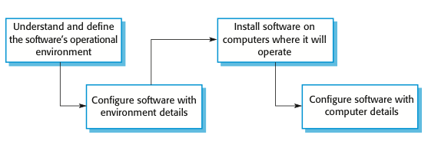
Software deployment软件部署
Chapter 14 Security Engineering

Slide 36
Configuration vulnerabilities配置漏洞
Vulnerable default settings
  Attackers can find out the default settings for software. If these are weak (often to increase usability) then they can be exploited by users when attacking a system.
Development rather than deployment
  Some configuration settings in systems are designed to support development and debugging. If these are not turned off, they can be a vulnerability that can be exploited by attackers.
Chapter 14 Security Engineering

Slide 37
Deployment support 1 部署支持
Include support for viewing and analyzing configurations
  Make sure that the system administrator responsible for deployment can easily view the entire configuration. This makes it easier to spot omissions and errors that have been made.
Minimize default privilege特权s and thus limit the damage that might be caused
  Design the system so that the default privileges for an administrator are minimized. This means that if someone gains admin access, they do not have immediate access to the features of the system.
Chapter 14 Security Engineering

Slide 38
Deployment support 2
Localize configuration settings
  When setting up a system, all information that is relevant to the same part or component of a system should be localized so that it is all set up at once. Otherwise, it is easy to forget to set up related security features.
Provide easy ways to fix security vulnerabilities
  When problems are detected, provide easy ways, such as auto-updating, to repair security vulnerabilities in the deployed systems.
Chapter 14 Security Engineering

Slide 39
14.3 System survivability系统可生存性
Survivability is an emergent system property that reflects the systems ability to deliver交付 essential services whilst同时 it is under attack or after part of the system has been damaged
Survivability analysis and design should be part of the security engineering process
Chapter 14 Security Engineering

Slide 40
Importance of survivability生存能力的重要性
Our economic and social lives are dependent on computer systems
  Critical infrastructure – electricity, gas, telecommunications, transport
  Healthcare
  Government
Loss of business systems商业系统 for even a short time can have very severe economic effects
  Airline reservation systems
  E-commerce systems
  Payment systems
Chapter 14 Security Engineering

Slide 41
Service availability 服务可用性/有效性
Which system services are the most critical for a business?
How might these services be compromised?
What is the minimal quality of service that must be maintained?
How can these services be protected?
If a service becomes unavailable, how quickly can it be recovered?
Chapter 14 Security Engineering

Slide 42
Survivability strategies生存策略
Resistance 阻力
  Avoiding problems by building capabilities into the system to resist attacks
Recognition识别
  Detecting problems by building capabilities into the system to detect attacks and failures and assess the resultant damage
Recovery恢复
  Tolerating problems by building capabilities into the system to deliver services whilst under attack
Chapter 14 Security Engineering

Slide 43
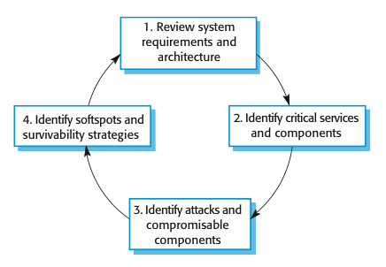
Stages in survivability analysis阶段生存能力分析
Chapter 14 Security Engineering

Slide 44
Key activities 关键活动
System understanding
  Review goals, requirements and architecture
Critical service identification
  Identify services that must be maintained
Attack simulation
  Devise attack scenarios and identify components affected
Survivability analysis
  Identify survivability strategies to be applied
Chapter 14 Security Engineering

Slide 45
Trading system survivability交易系统生存能力
User accounts and equity prices replicated across servers so some provision for survivability made
Key capability to be maintained is the ability to place orders for stock
Orders must be accurate and reflect the actual sales/purchases made by a trader
Chapter 14 Security Engineering

Slide 46
Survivable ordering service可生存的订购服务
The critical service that must survive is the ability for authorized users to place orders for stock
This requires 3 components of the system to be available and operating reliability:
  User authentication, allowing authorized users to log on to the system
  Price quotation, allowing buying and selling prices to be quoted
  Order placement, allowing buy and sell orders to be made
Chapter 14 Security Engineering

Slide 47
Possible attacks可能的攻击
Malicious user masquerades as a legitimate user and places malicious orders for stock, with the aim of causing problems for the legitimate user
An unauthorized user corrupts the database of transactions thus making reconciliation of sales and purchases impossible
Chapter 14 Security Engineering

Slide 48
Survivability analysis in an equity trading system个股票交易系统生存能力分析
Attack | Resistance | Recognition | Recovery
Unauthorized user places malicious orders | Require a dealing password that is different from the login password to place orders. | Send copy of order by e-mail to authorized user with contact phone number (so that they can detect malicious orders). Maintain user’s order history and check for unusual trading patterns. | Provide mechanism to automatically ‘undo’ trades and restore user accounts. Refund users for losses that are due to malicious trading. Insure against consequential losses.
Corruption of transactions database | Require privileged users to be authorized using a stronger authentication mechanism, such as digital certificates. | Maintain read-only copies of transactions for an office on an international server. Periodically compare transactions to check for corruption. Maintain cryptographic checksum with all transaction records to detect corruption. | Recover database from backup copies. Provide a mechanism to replay trades from a specified time to re-create the transactions database.

Slide 49
Key points
General security guidelines sensitize designers to security issues and serve as review checklists
Configuration visualization, setting localization, and minimization of default privileges help reduce deployment errors
System survivability reflects the ability of a system to deliver services whilst under attack or after part of the system has been damaged.
Chapter 14 Security Engineering

